Slide 1
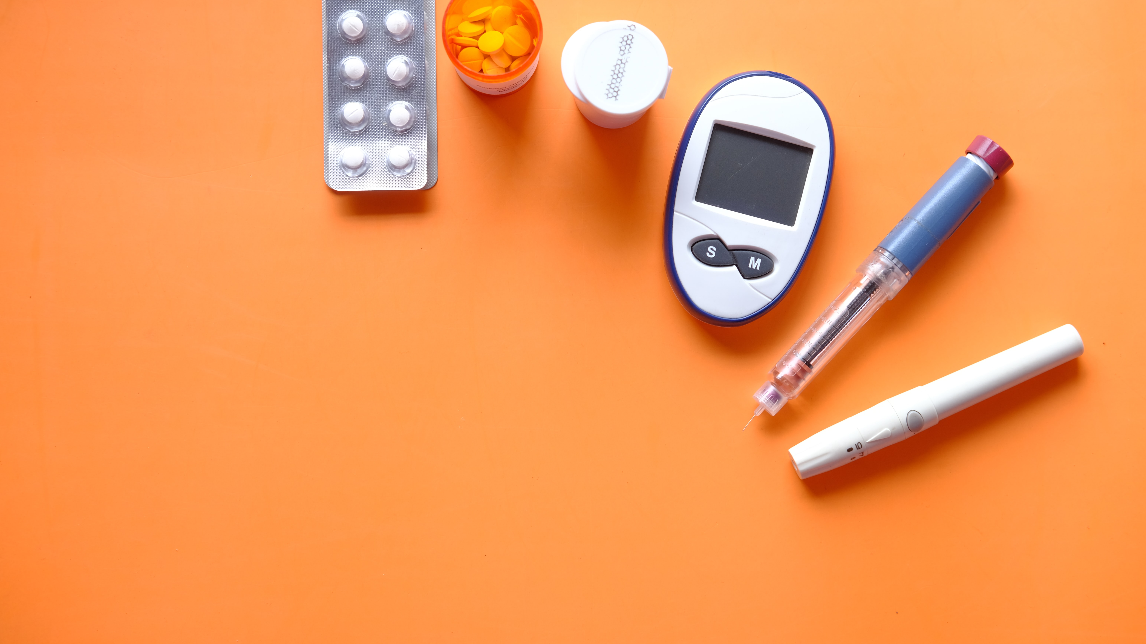

Diabetes Prediction
Dr. Siadat – Reza Barahmand
Kharazmi University
School of Business
MBA – MIS

Slide 2

Contents
Introduction
Internet of Medical Things
Diabetes
Objectives
Data (Pima Indians)
Methodology
Over All Pipeline
Data Cleaning and Pre-processing
Cleaning
Sampling
Feature Engineering
ML Models
Naïve Bayes Classifier
Random Forest
SVM
…
Results
Evaluation Metric
Accuracy
Recall
ROC-AUC
WMSE
Scores
Overall Best Model
Conclusion
Future Works
Resources
Kharazmi University – Diabetes Prediction

Slide 3

Introduction
Internet of Medical Things
Application of the Internet of Things (IoT) in the medical field
Network technologies and it’s connection with medical equipment
Healthcare IT systems
Remote (lacking medical experts)
Constant data computation
Benefit of using patient records
Lower the cost of medical services
Delivering feedback to medical staff
ML techniques used because of the large amount of data
Combination of AI and IoMT is a game changer in this field
Kharazmi University – Diabetes Prediction

Slide 4
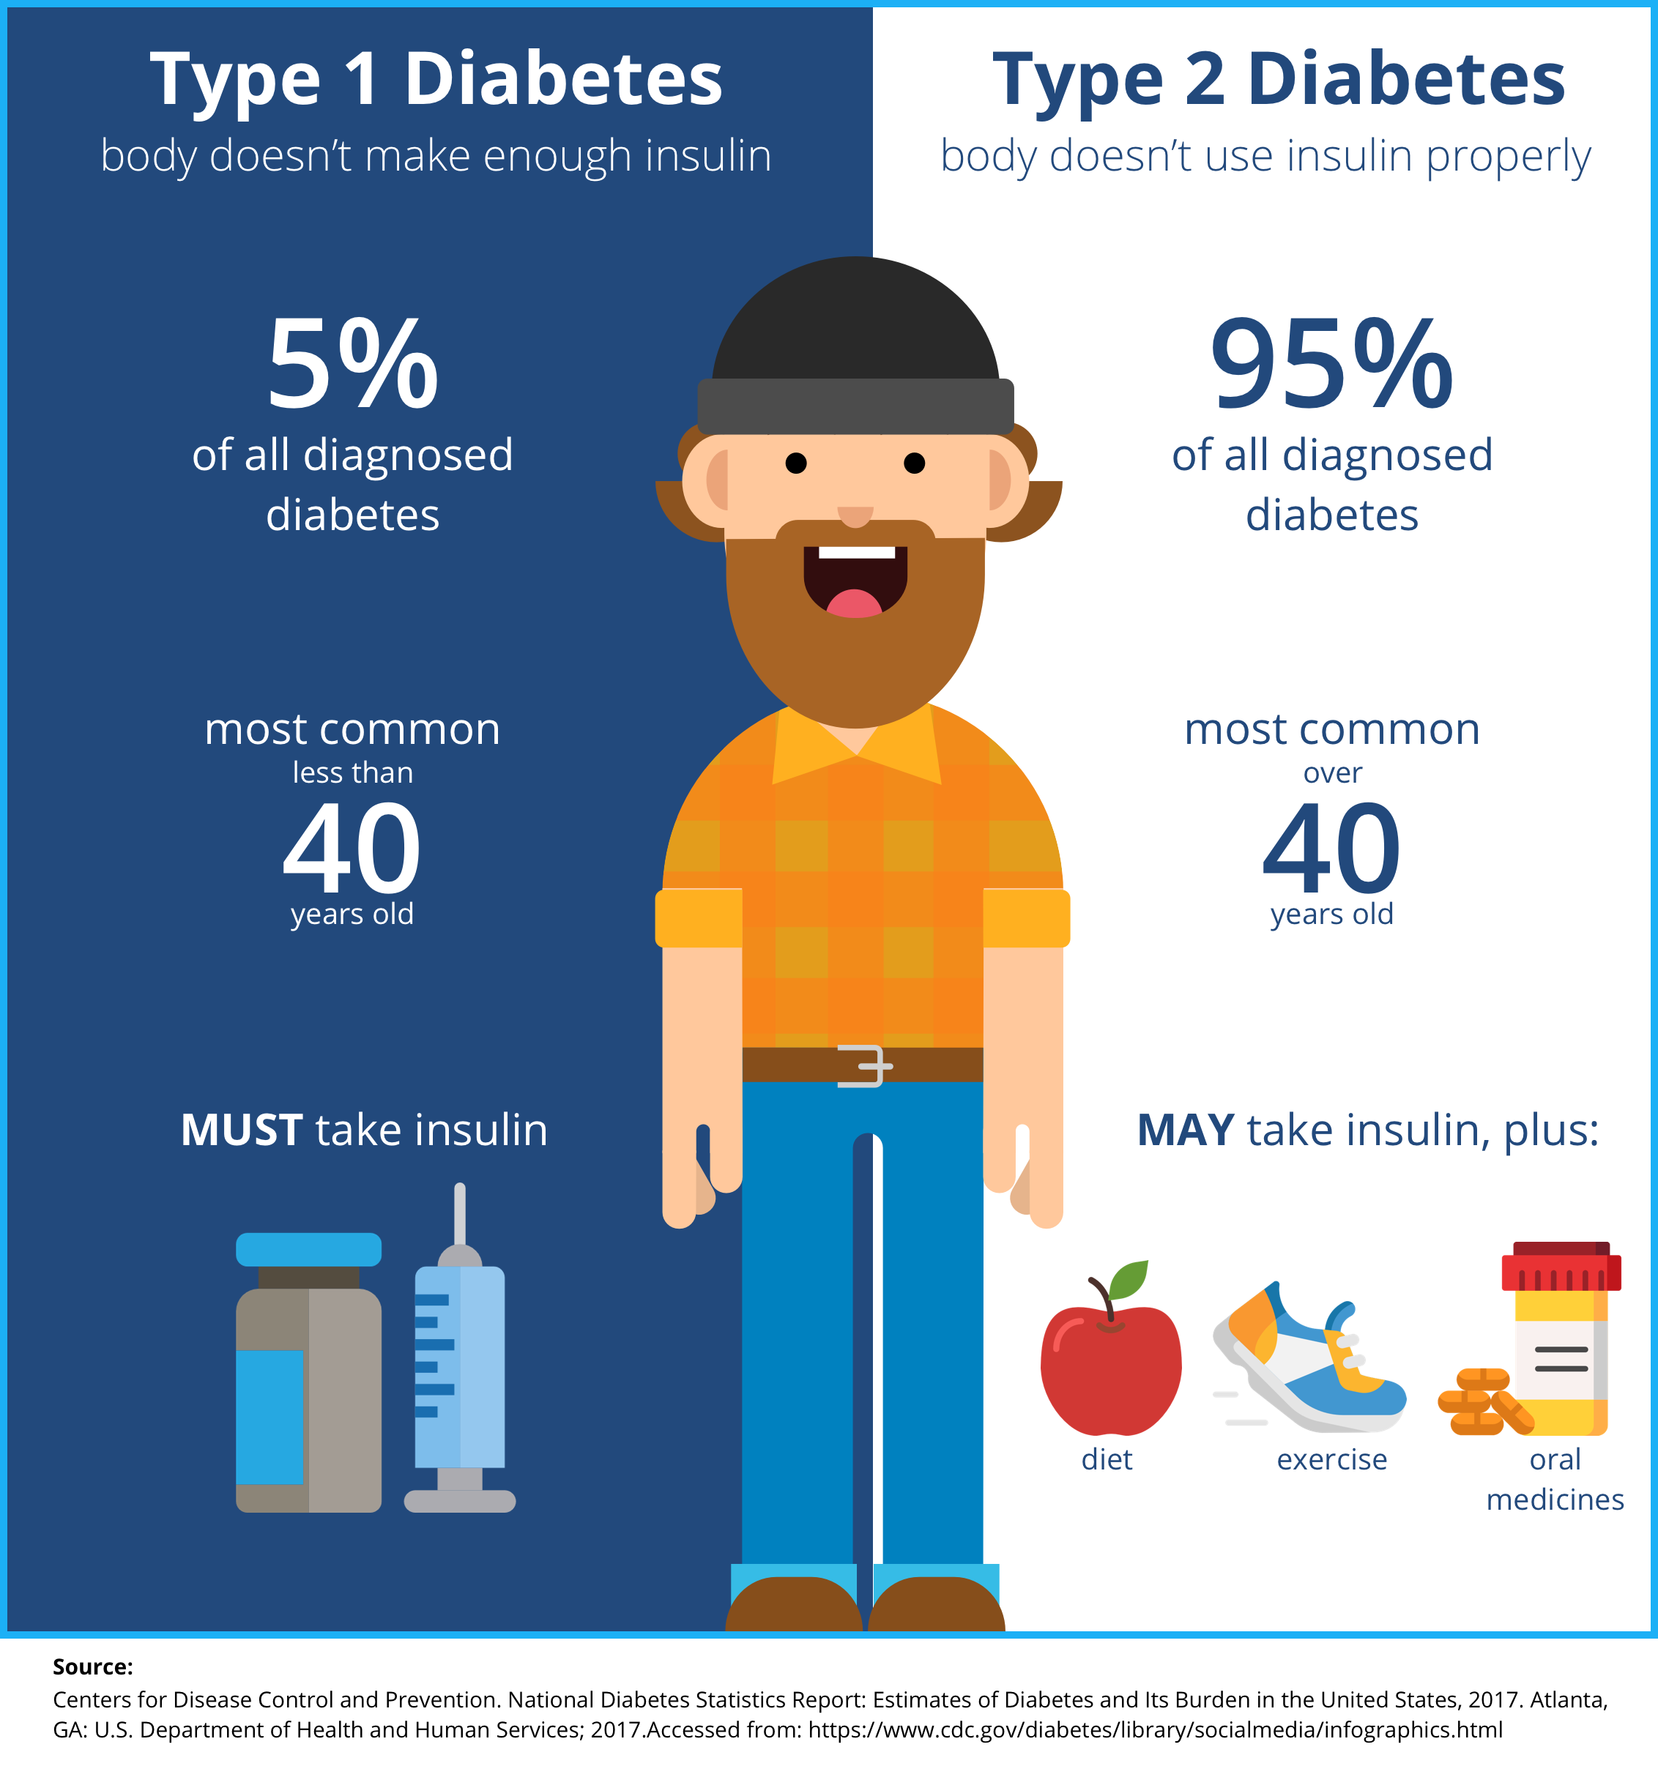
Introduction
Diabetes
Chronic illness
Develops in 2 situations:
Pancreas are not able to generate sufficient insulin
Body does not utilize the insulin produced effectively
Why people get it?
Genetic factors
Environmental factors
Type 1:
Need to inject insulin every day
Has no cure
Type 2 (our main focus):
Blood sugar need to be testes constantly
Can be prevented in early stages with healthy diet
Kharazmi University – Diabetes Prediction

Slide 5
Introduction
Objectives
Early detection of diabetes
Using patient records to accelerate the diagnostic procedure.
Using ML and DL to achieve maximum accuracy in prediction.
Remote prediction (lacking medical experts)
Provide doctors; preliminary diagnosis
Feedback doctors about patient records
Diet
Exercise
Blood glucose testing
Kharazmi University – Diabetes Prediction

Slide 6
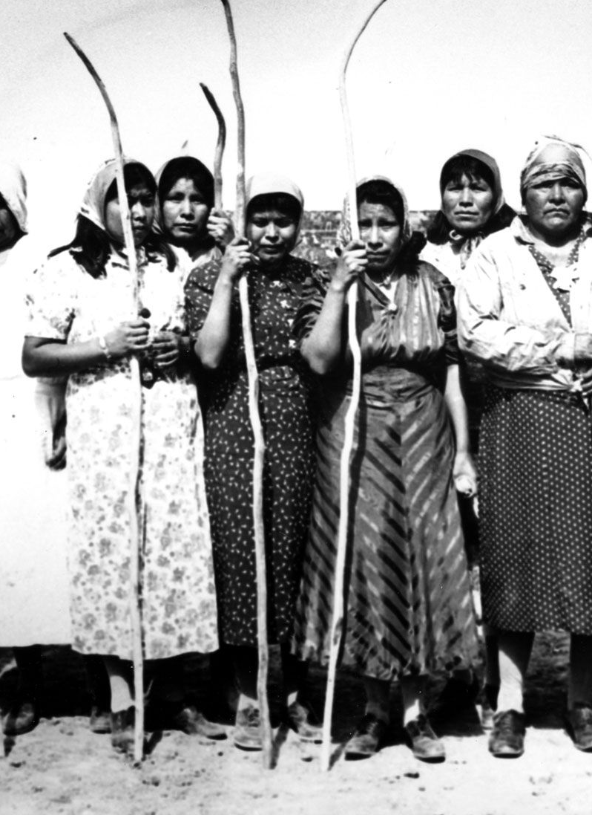
Introduction
Pima Indians Diabetes Dataset
National Institute of Diabetes and Digestive and Kidney Diseases
All patients here are females at least 21 years old of Pima Indian heritage (768 records)
Predictor variables (8 features):
Number of pregnancies
Glucose
Blood pressure
Skin Thickness
…
Target Value:
1 = Has diabetes
0 = Does not have diabetes
Data problems
Some values inserted as zero that is no possible
Data suffers from outliers in some fields
Data lacks standardization
Imbalanced target
Kharazmi University – Diabetes Prediction

Slide 7
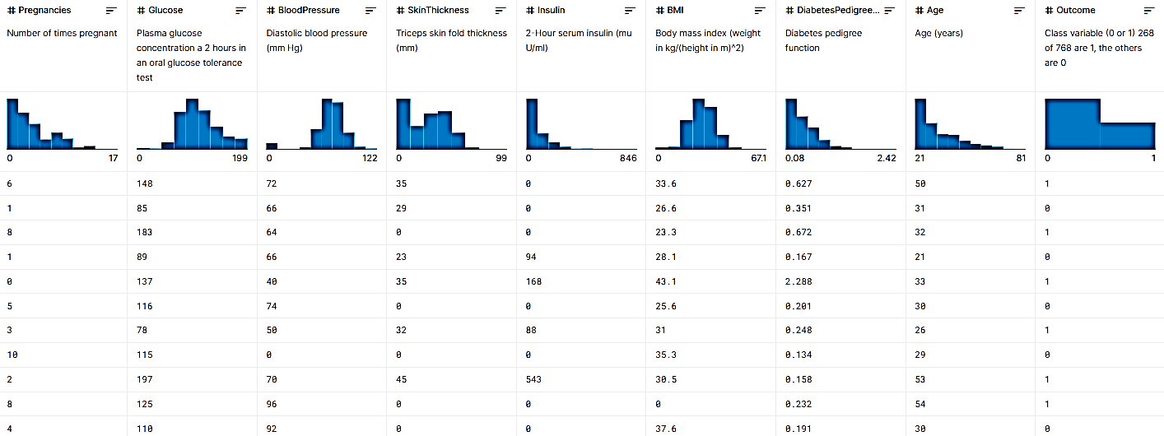
Introduction
Pima Indians Diabetes Dataset
Kharazmi University – Diabetes Prediction

Slide 8
Methodology
Data Mining Based Prediction Techniques
Classification-based:
Supervised
Data preparation is a plus
Regression-based:
Statistical
Based on relationship between 2 feature
Association-based:
Extracting frequent pattern and correlations
Clustering-based:
Unsupervised
Base on similarity
SPM (Sequential Pattern Mining)
Finding patterns, happened orderly.
Hybrid
Combination of different models
Most robust one
Kharazmi University – Diabetes Prediction

Slide 9
Methodology
Over All Pipeline (Mine)
Data Preparation
Data Cleaning:
Data duplication
Noisy data
Outliers
Missing data
Feature Engineering:
Standardization
Feature encoding
Feature selection
Feature extraction
Imbalanced data
Modeling
Data Sampling:
Stratification
Cross validation
Modeling:
Best model selection
Hyper parameter tuning
Optimization
Evaluation
Results:
Max prediction score
Best evaluation metric
Prevent overfitting
Implement the model
Final test
Visualizations
Kharazmi University – Diabetes Prediction

Slide 10
Methodology
Over All Pipeline (Classic ML Model)
Data Preparation
Data Cleaning:
Missing data (Imputation)
Feature Engineering:
Standardization
Feature selection (Correlation)
Modeling
Data Sampling:
80-20% sampling
Modeling:
Naïve bayes
J48 decision tree
Random forest
Hyper parameter tuning
Evaluation
Results:
Max prediction score
Best evaluation metric
Implement the model
Visualizations
Kharazmi University – Diabetes Prediction

Slide 11
Methodology
Over All Pipeline (Neural Network)
Data Preparation
Data Cleaning:
Feature Engineering:
Neural network
NN Auto scaling
Modeling
Data Sampling:
Neural Network
Modeling:
Quasi-Newton Model
NN optimization
Performance function
Learning Rate
Numbers of epoch
Evaluation
Results:
Min error scores
Implement the model
Visualizations
Kharazmi University – Diabetes Prediction

Slide 12
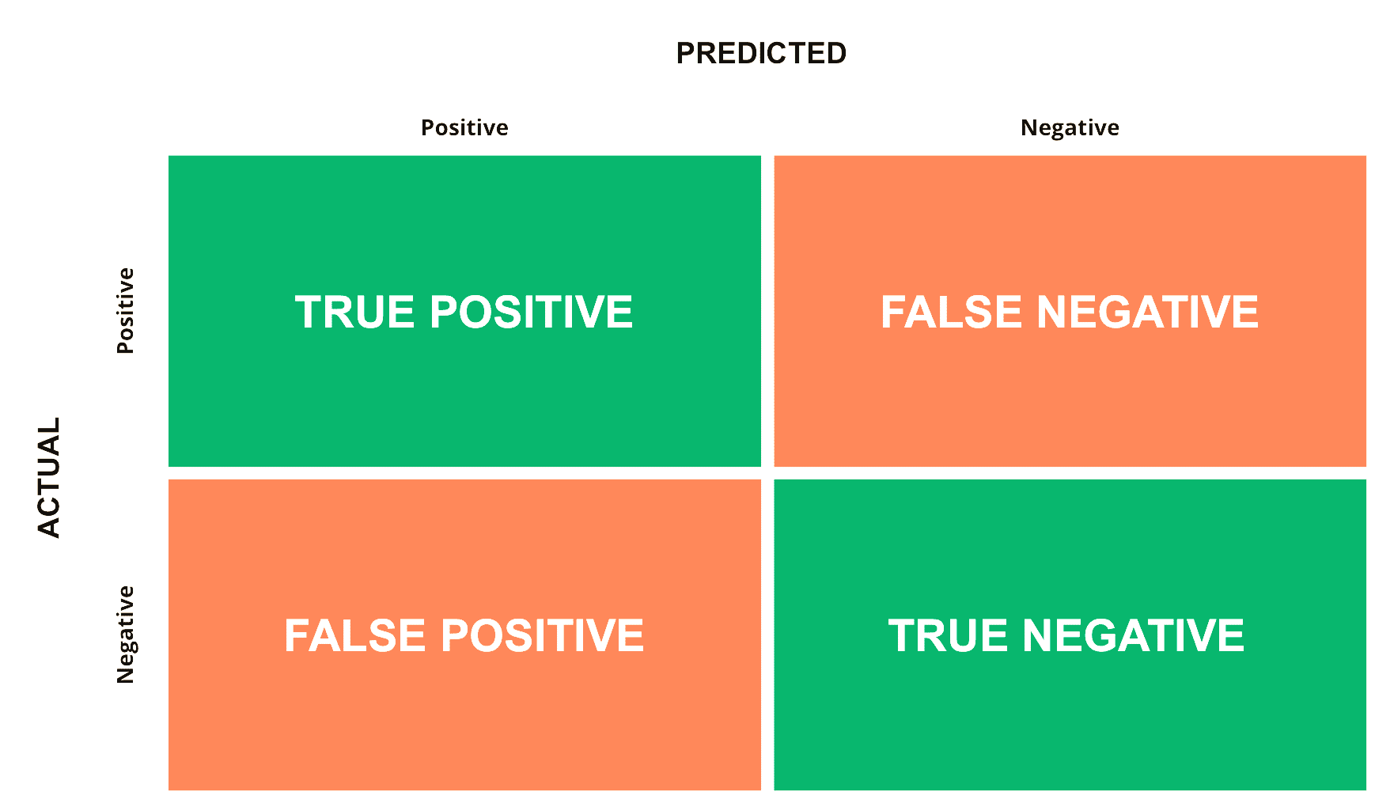
Results
Confusion Matrix
Kharazmi University – Diabetes Prediction

Slide 13
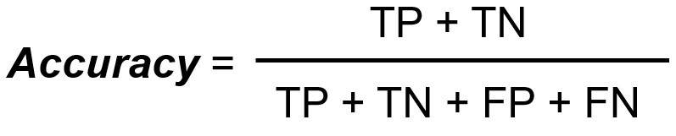
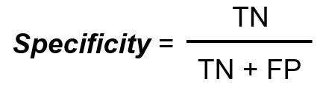
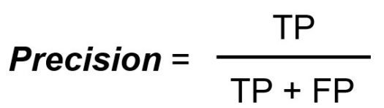
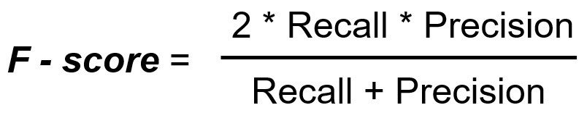
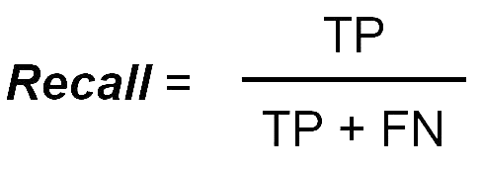
Results
Evaluation Metrics
Kharazmi University – Diabetes Prediction

Slide 14
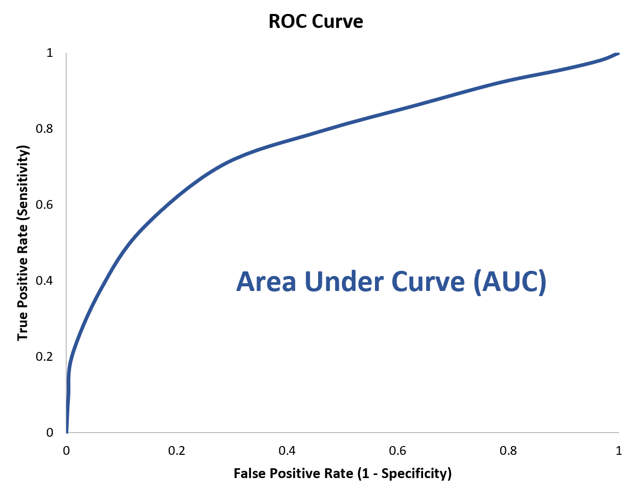
Results
Evaluation Metrics (ROC-AUC)
Kharazmi University – Diabetes Prediction

Slide 15
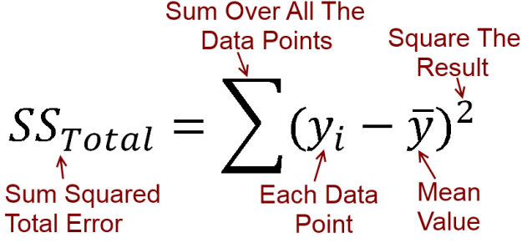
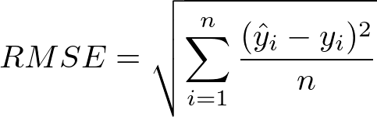
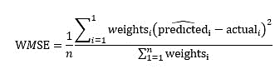
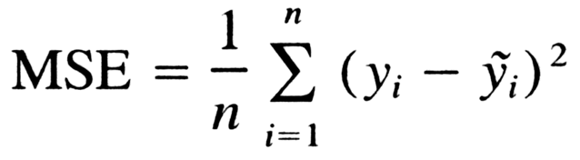
Results
Error Scores
Suitable for imbalanced classes
Kharazmi University – Diabetes Prediction

Slide 16
Results
Best Evaluation Metric
Kharazmi University – Diabetes Prediction

Slide 17
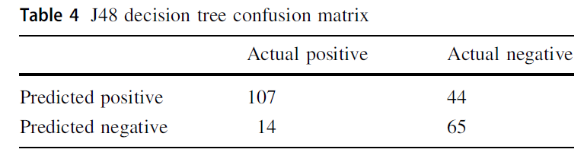
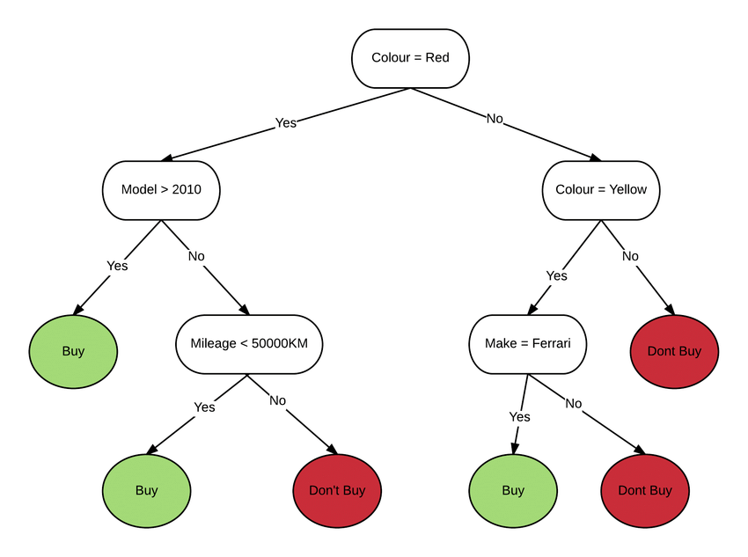
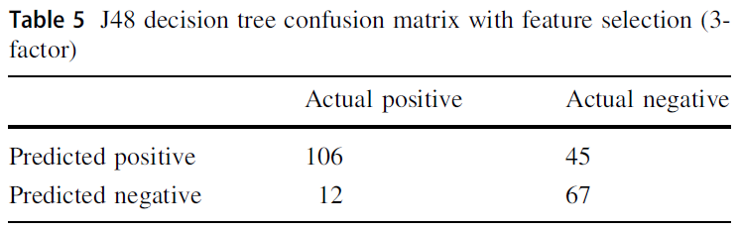
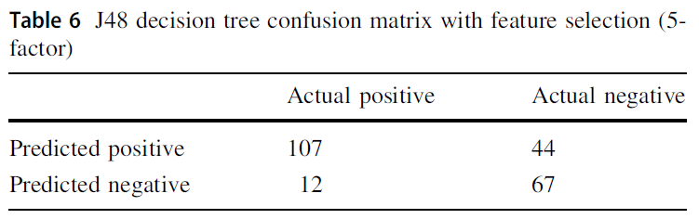
Results
Classic Models Results (J48 decision tree)
Kharazmi University – Diabetes Prediction

Slide 18
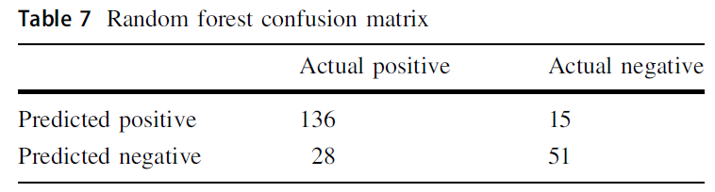

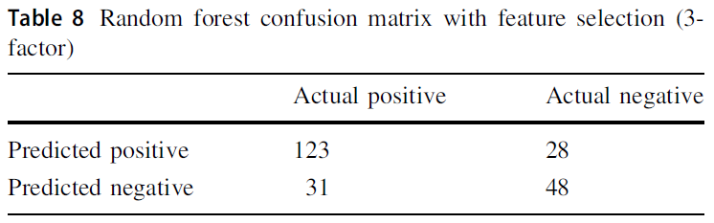
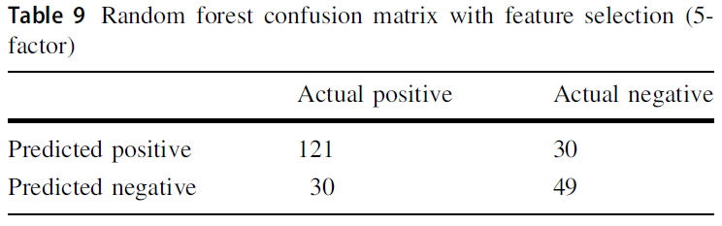
Results
Classic Models Results (Random Forest)
Kharazmi University – Diabetes Prediction

Slide 19
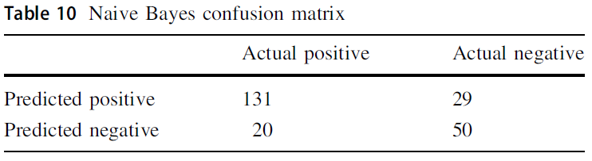
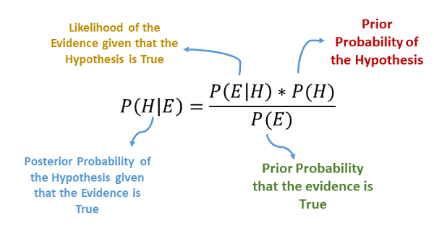
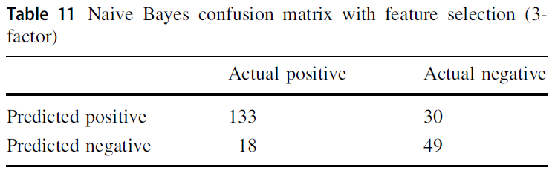
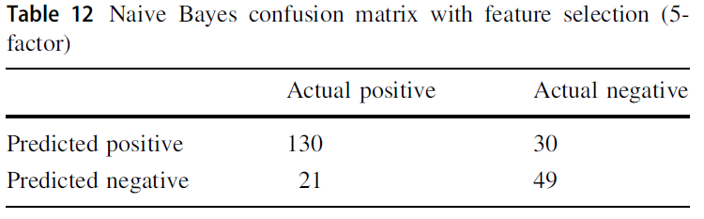
Results
Classic Models Results (Naïve Bayes)
Kharazmi University – Diabetes Prediction

Slide 20
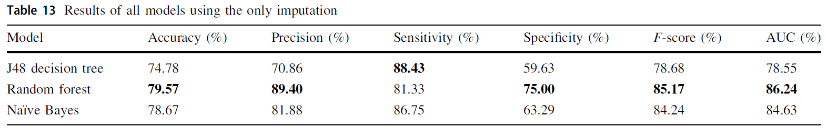
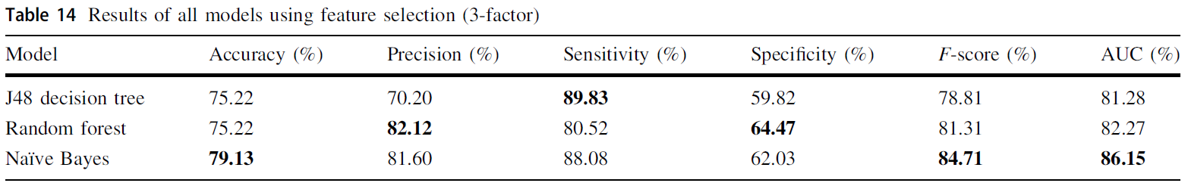
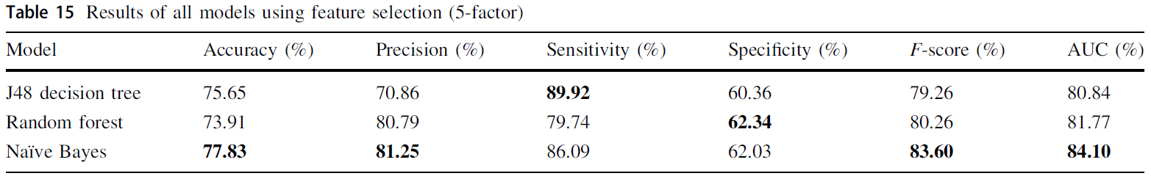
Results
Classic Models Results (All Models)
Kharazmi University – Diabetes Prediction

Slide 21
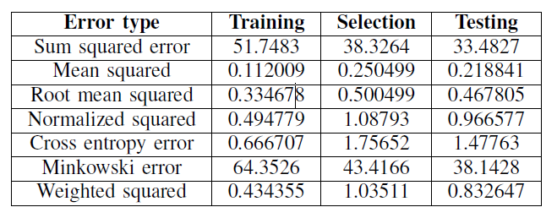
Results
Neural Network Results (All Models)
Feature | Values
Pregnancies | 3.84505
Glucose | 120.895
Blood Pressure | 69.1055
Skin Thickness | 20.5365
Insulin | 79.7995
BMI | 31.9926
DPF | 0.471876
Age | 50.2409
Outcome | 0.494677295
Example output of NN
Error table
Kharazmi University – Diabetes Prediction

Slide 22
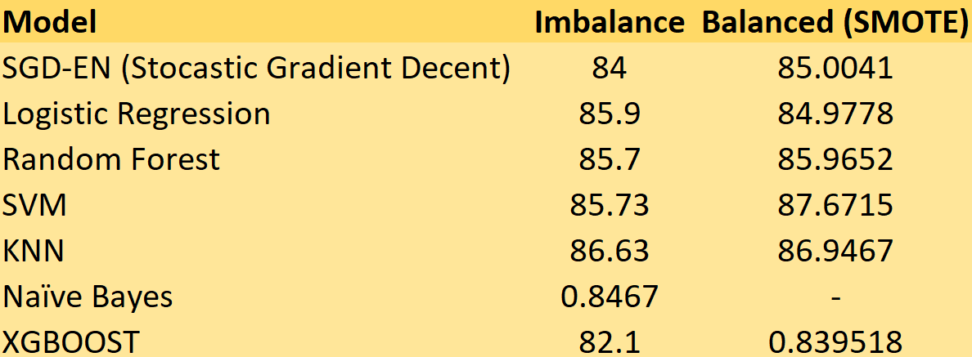
Results
Overall Best Results (Best Model Selected)
Model | Score
SVM (Mine) | ROC-AUC = 87.6715 %
Random Forest | ROC-AUC = 86.24 %
J48 Decision Tree | ROC-AUC = 81.28 %
Naïve Bayes | ROC-AUC = 86.15 %
Neural Networks | WMSE = 0.434355 (train) – 0.832647 (test)
Maximum Ever | ROC-AUC = 90.12 %
Kharazmi University – Diabetes Prediction

Slide 23
Future Works
Challenges and Recommendations
Data:
Availability of relevant accurate and quality data
Data collection and sharing
Data privacy & security
Data integration
Data access and storage
Data preparation:
Appropriate data selection
Data cleaning
Feature selection and extraction
Dimensionality reduction
Feature engineering
Diagnosis and Prediction Techniques:
Generic and universal technique
Clinical and public usability
Evaluation of existing techniques over new datasets
Robust software tools
Development a Realtime prediction system
Appropriate model selection
Integration of models from different domains
Higher efficiency and accuracy
Kharazmi University – Diabetes Prediction

Slide 24
Resources
Victor Chang et al. Pima Indians diabetes mellitus classification based on machine learning (ML) algorithms. https://link.springer.com/article/10.1007/s00521-022-07049-z. 2022.
Farrukh Aslam Khan et al. Detection and Prediction of Diabetes Using Data Mining: A Comprehensive Review. https://doi.org/10.1109/ACCESS.2021.3059343. 2021.
Kamlesh Lakhwani et al. Prediction of the Onset of Diabetes Using Artificial Neural Network and Pima Indians Diabetes Dataset. https://doi.org/10.1109/ICRAIE51050.2020.9358308. 2020.
Pima Indian Diabetes Dataset. https://www.kaggle.com/datasets/uciml/pima-indians-diabetes-database.
Jason Brownlee. Imbalanced Classification with Python. https://machinelearningmastery.com/imbalanced-classification-with-python\. 2021.
Jason Brownlee. Data Preparation for Machine Learning. https://machinelearningmastery.com/data-preparation-for-machine-learning/. 2020.
Reza Barahmand. Jupyter Notebook and Results. https://github.com/rbarahmand/2-years-data-scince-journey/tree/master/docs/myCodes/pima-Indians. 2022.
IBM CRISP Methodology. https://inseaddataanalytics.github.io/INSEADAnalytics/CRISP_DM.pdf. 2011.
Kharazmi University – Diabetes Prediction

Slide 25
Contents
Introduction
Internet of Medical Things
Diabetes
Objectives
Data (Pima Indians)
Methodology
Over All Pipeline
Data Cleaning and Pre-processing
Cleaning
Sampling
Feature Engineering
ML Models
Naïve Bayes Classifier
Random Forest
SVM
…
Results
Evaluation Metric
Accuracy
Recall
ROC-AUC
WMSE
Scores
Overall Best Model
Conclusion
Future Works
Resources
Kharazmi University – Diabetes Prediction

Slide 26
THANKS !
thanks!
Any questions?
@rbarahmand

